Slide 1

Beyond Traditional Techniques: Exploring Advanced Embeddings and K-means++ for scRNA-seq analysis
By Vered Klein and Sigal Grabois

Slide 2
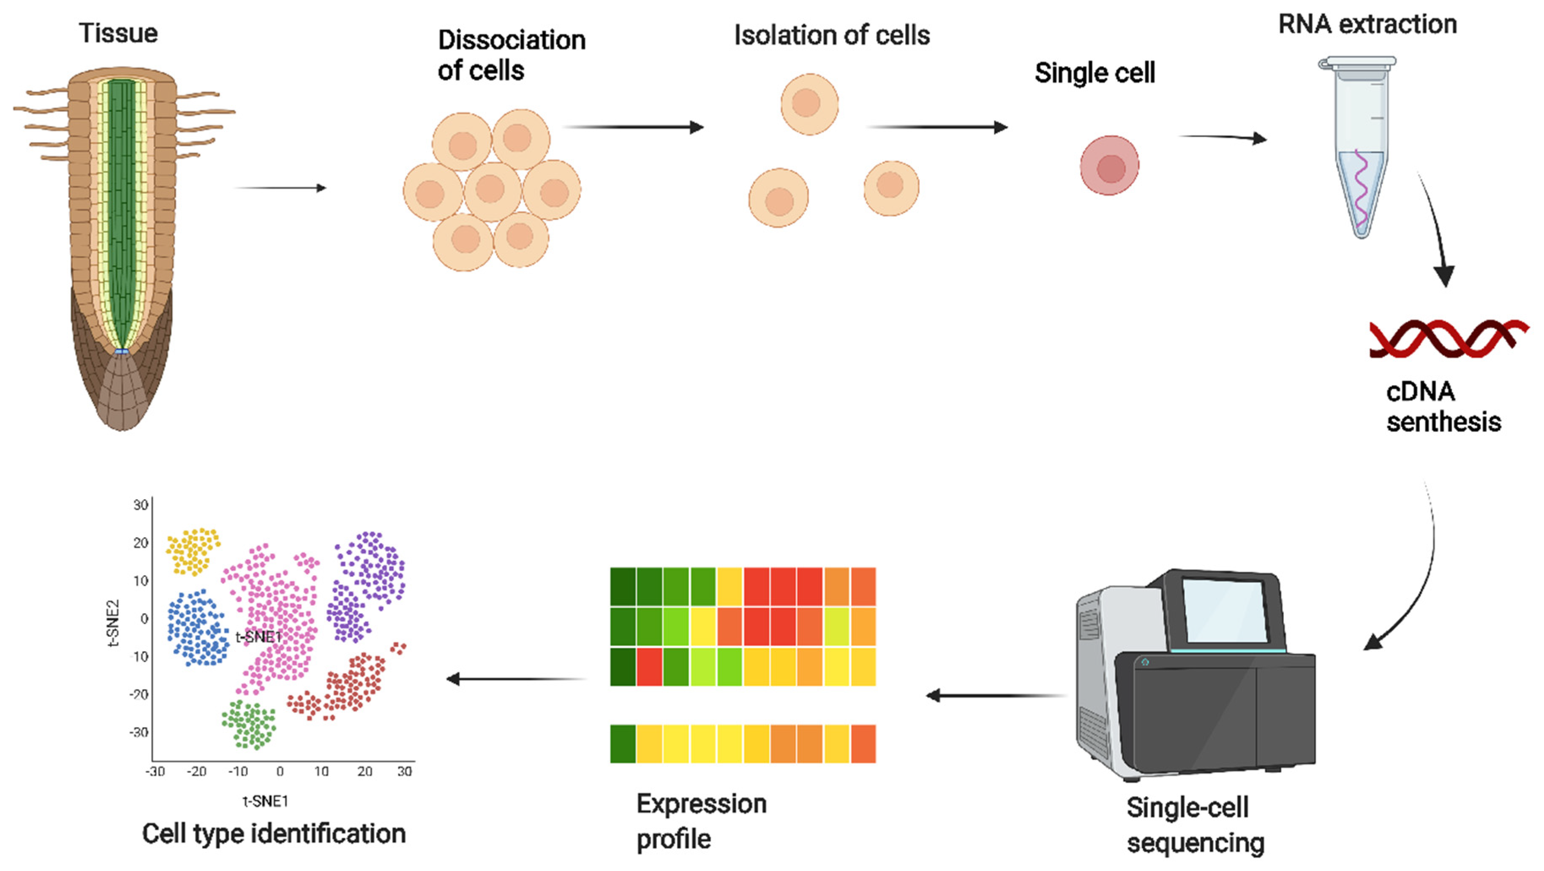
Background and motivation
Analyzing single-cell RNA-sequencing (scRNA-seq) data is essential for advancing understanding of cell biology, disease mechanisms, and the drug development process.
Int. J. Mol. Sci. 2022, 23(9), 4497; https://doi.org/10.3390/ijms23094497
Notes:
Analyzing single-cell RNA-sequencing (scRNA-seq) data is essential for advancing our understanding of cell biology, exploring disease mechanisms, and enhancing the drug development process.
A fundamental step in scRNA-seq data analysis is cell type clustering, which organizes cells into groups based on gene expression patterns. This initial clustering significantly influences subsequent analyses and interpretations.

Slide 3
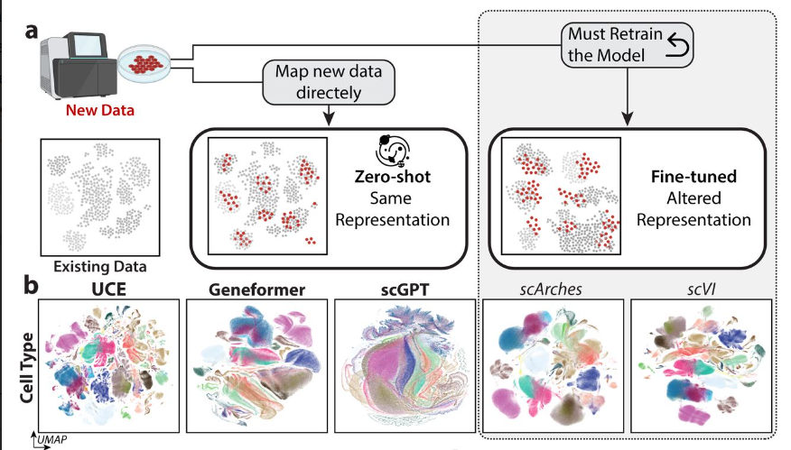
The problem
Notes:
The traditional methods for analyzing scRNA-seq data mainly rely on raw gene expression data, which can be noisy and lack comprehensive information.
Other self-supervised methods (e.g., Geneformer[], scGPT[]) depend on cell type annotations, limiting their applicability to unseen cell types or datasets.
Moreover, non-zero-shot methods (e.g., scVI[], scArches[]) typically require model tuning for each new dataset, rendering the representations non-universal, without re-training, which is inefficient and time consuming, we might lose efficiency with new data.

Slide 4
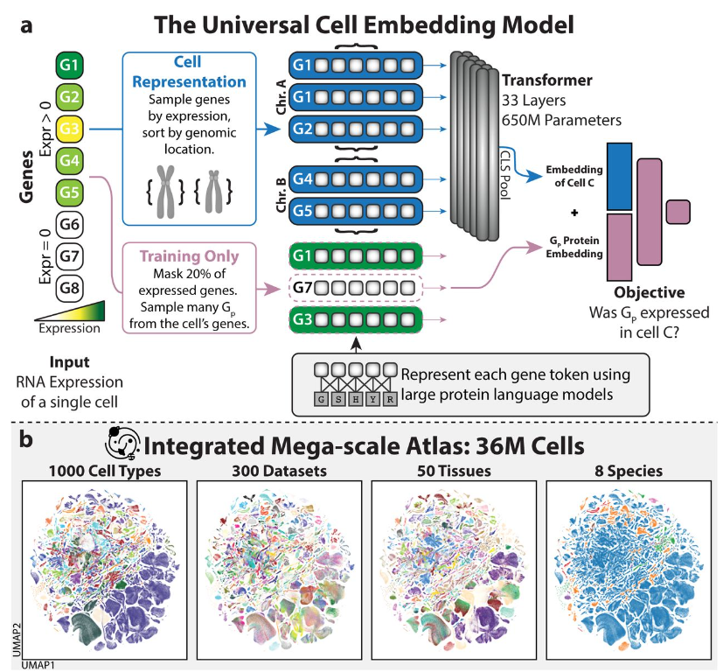

Universal Cell Embeddings: A Foundation Model for Cell Biology
Self-supervised (UCE) model for mapping single-cell gene expression profiles into a universal embedding space.
UCE defines a function $f_{u}:{\left\{ℕ^{k_{i}} → ℝ^{1280}\right\}}_{i=1}^{N}$ that maps each gene expression vector to its cell embedding vector.
Yanay Rosen, Yusuf Roohani, Ayush Agarwal, Leon Samotorčan, Tabula Sapiens Consortium, Stephen R. Quake, Jure Leskovec doi: https://doi.org/10.1101/2023.11.28.568918
Notes:
self-supervised Universal Cell Embedding (UCE) model, which aims to create a universal representation of cells to encapsulate the vast molecular diversity across different cell types and species. It offers a universal biological latent space denoted by U that can represent any cell, regardless of tissue or species. The paper discusses how UCE abstracts cells as 'bags of RNA' and uses a large protein language model to convert genes into their protein products.

Slide 5
Universal Cell Embeddings: A Foundation Model for Cell Biology
Most IMA data (33.9 million cells and 285 datasets) is human and mouse data (from CZI Cell X Gene (CxG) Census version ”2023-07-10” (July 10th, 2023)).
Yanay Rosen, Yusuf Roohani, Ayush Agarwal, Leon Samotorčan, Tabula Sapiens Consortium, Stephen R. Quake, Jure Leskovec doi: https://doi.org/10.1101/2023.11.28.568918
Notes:
self-supervised Universal Cell Embedding (UCE) model, which aims to create a universal representation of cells to encapsulate the vast molecular diversity across different cell types and species. It offers a universal biological latent space denoted by U that can represent any cell, regardless of tissue or species. The paper discusses how UCE abstracts cells as 'bags of RNA' and uses a large protein language model to convert genes into their protein products.

Slide 6

The disadvantages of UCE
Complexity
Limited Explainability
Data Dependence
Potential for Overfitting
Notes:
Disadvantages of UCE:
Complexity: The model is computationally expensive due to its reliance on a large protein language model and transformer architecture.
Limited Explainability: Understanding how UCE arrives at cell representations can be challenging.
Data Dependence: The quality of UCE's zero-shot embeddings might be limited by the comprehensiveness of the training data.
Potential for Overfitting: UCE could be overfit to the training data, leading to biased predictions for under-represented cell types.

Slide 7
Our Solution:
1. Integrate advanced embedding techniques :
Embed single-cell data with UCE, Cell2Sentence; compare with PCA and original data.
2. K-means++ Modification
Modify K-means++ using local density for better clustering accuracy.
Cell embedding
UCE
Cell type clustering
Goal: improved cluster accuracy
PCA
K-means++
Original data
Modified K-means++
Cell2Sentence
Notes:
denser areas have a higher impact on the centroid’s new location.

Slide 8
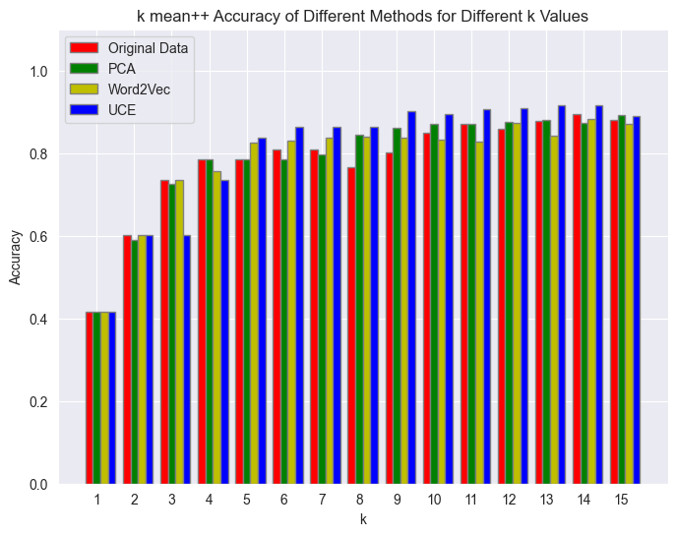
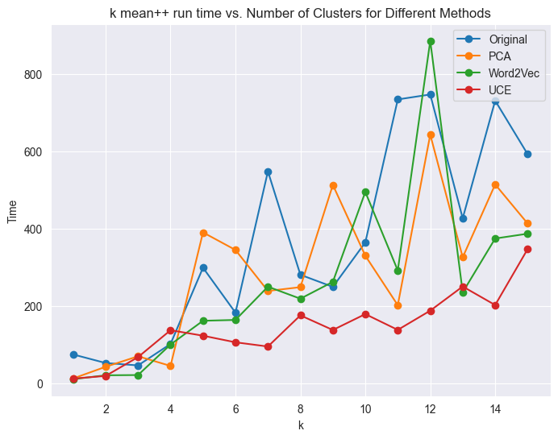
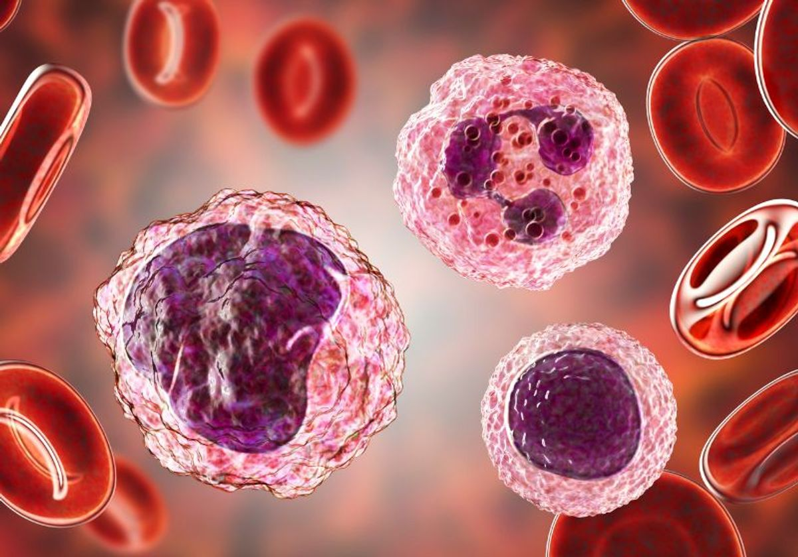
Results – 10K pbmc data set
Data set includes 11,990 Cell samples.

Slide 9
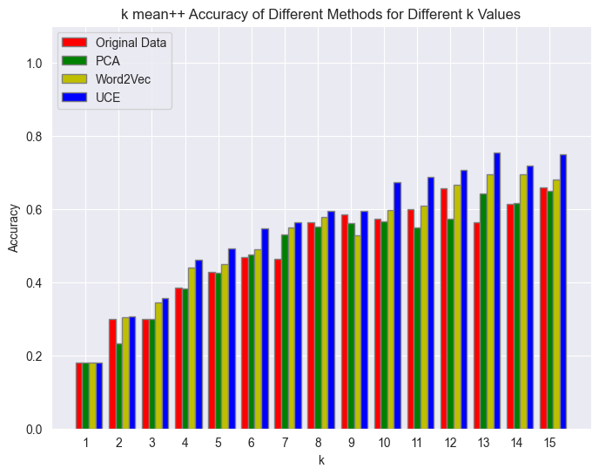

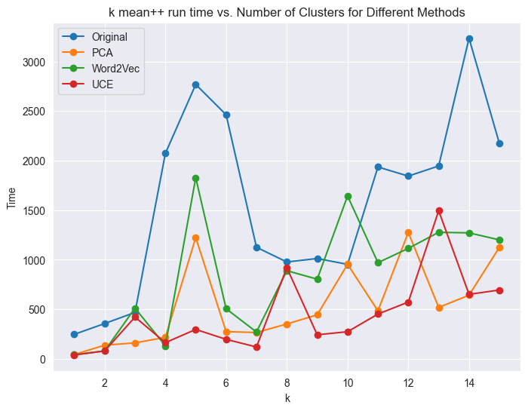
Results – mouse Kidney data set
Data set includes 35,833 Cell samples.

Slide 10
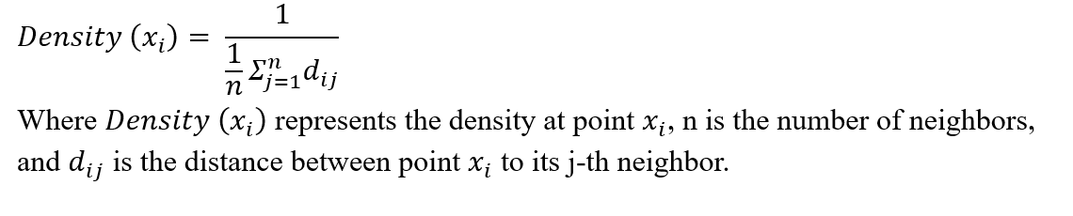
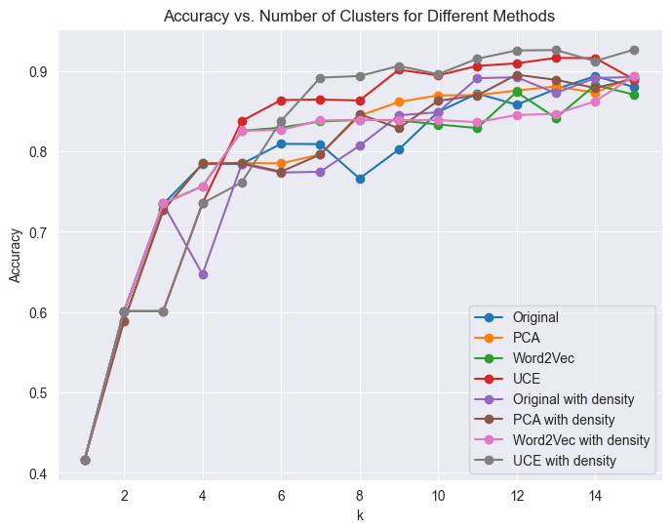
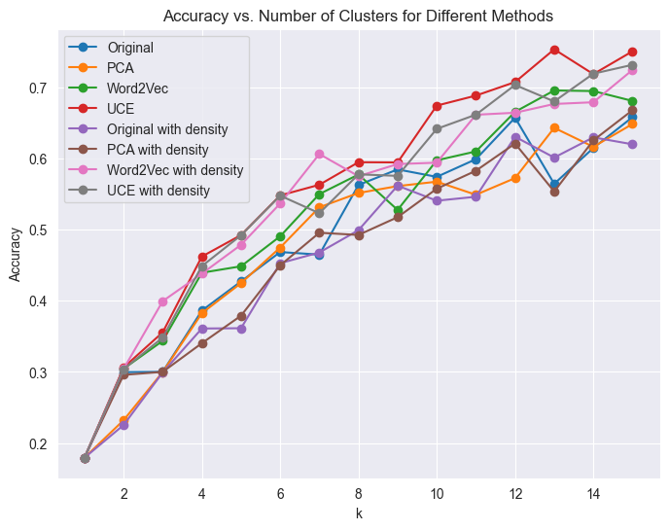
Follow-up study
K means++ with density weighted centroid update
10K pbmc dataset
Mouse kidney dataset

Slide 11
In conclusion
Notes:
In conclusion, the integration of advanced embedding techniques with enhanced clustering algorithms holds promise for improving the analysis of heterogeneous cellular data. Future studies should explore the scalability of these methods and their applicability to larger and more diverse datasets.

